Slide 1

Allianz SOCIAL MEDIA Sentiment Analysis
Prototype Dashboard
…….
Allianz Global Hackathon 20 November 2020
Strictly Confidential

Slide 2
Importance of social media sentiment
Use advanced targeting options easily​
Unlimited Adhoc Search​
Powerful Analytic​
Grow your brand’s reputation
Early warning system

Slide 3
What social media sentiment analysis can do
Output & Advantage
Social Analytic Dashboard
Overview and provide in depth analysis on all social media sources include campaign tracking​
Library of widgets (Sentiment, Social Reach, Trending themes, Location and Top Publication)​
Prediction and follow up action link to CRM system ​
Worldwide can be used to see social media in others OE*​
Able to identify Negative, Positive and Neutral sentiment​
Able to search for specific campaign-related keywords
Early Warning System
Pushup Notification via e-mail as responding to keyword or negative sentiment by real time​
Early notification of any sensitive contents/conversation via e-mail and push notification by real time
Further Development
Action Recommendation
Competitor Analysis
Leads Tracking
Languages adjustment (other than Indonesian and English)
Push Notification of negative contents

Slide 4
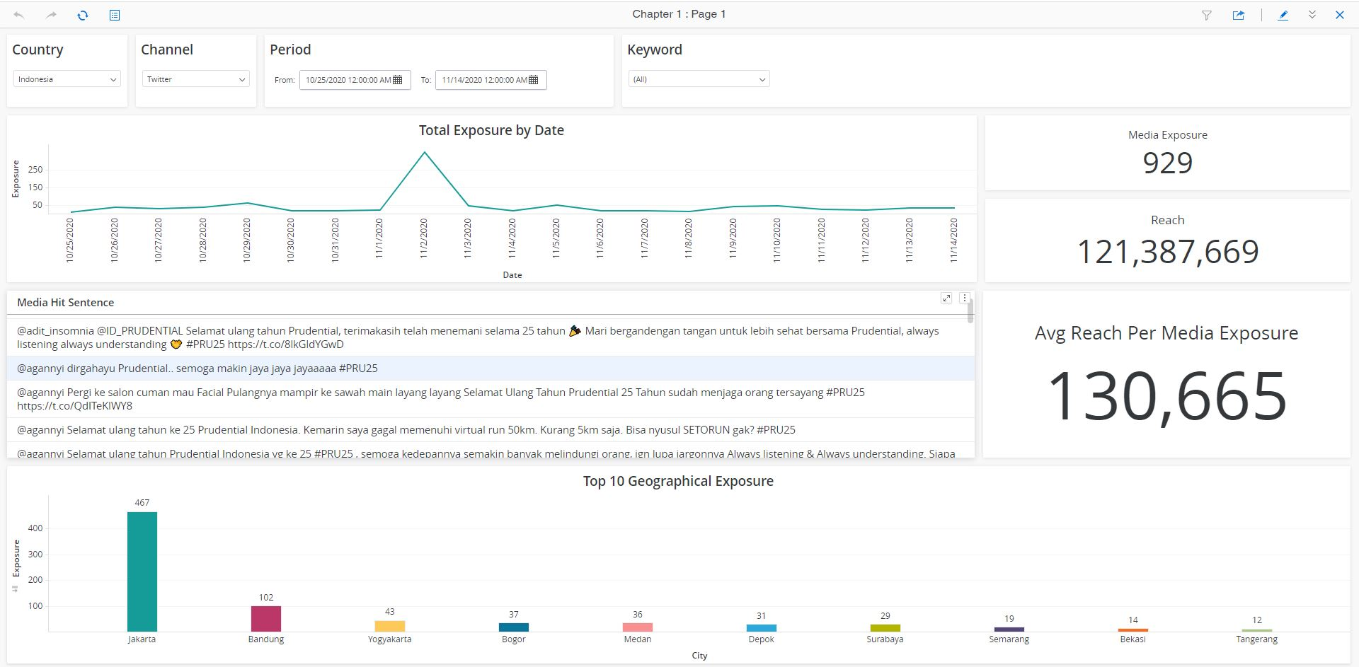
Dashboard – Page 1

Slide 5
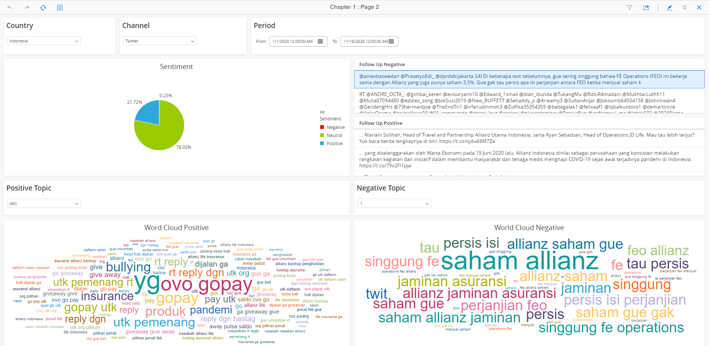
Dashboard – Page 2

